Slide 1

Department of Computer Application
Institute of Technical Education and Research(ITER)
Siksha O Anusandhan Deemed to be University
Bhubaneswar-30
Segmentation and Paging
Presented By::
MANYU KUMAR
REGD NO: 2141011082

Slide 2
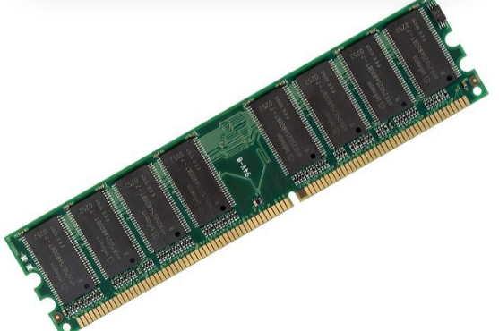
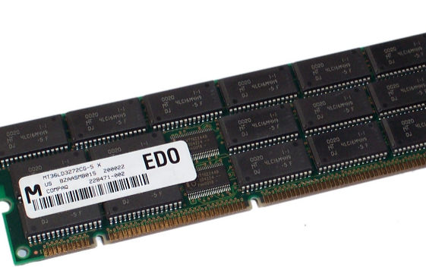
Segmentation and Paging
In operating systems, efficient memory management is crucial for optimal performance. Two important techniques used for this purpose are segmentation and paging. Segmentation divides the memory into variable-sized logical units based on program structure, such as functions or data blocks, making it easier to manage and access. On the other hand, paging breaks memory into fixed-size blocks, called pages, which helps eliminate external fragmentation and allows for better utilization of memory. Both methods aim to provide a way to allocate memory effectively and ensure smooth execution of processes.

Slide 3

Content
Basics of Memory Management
Understanding Segmentation in Memory Management
Paging Mechanism
Address Translation Process
Advantages and Disadvantages of Memory Management

Slide 4
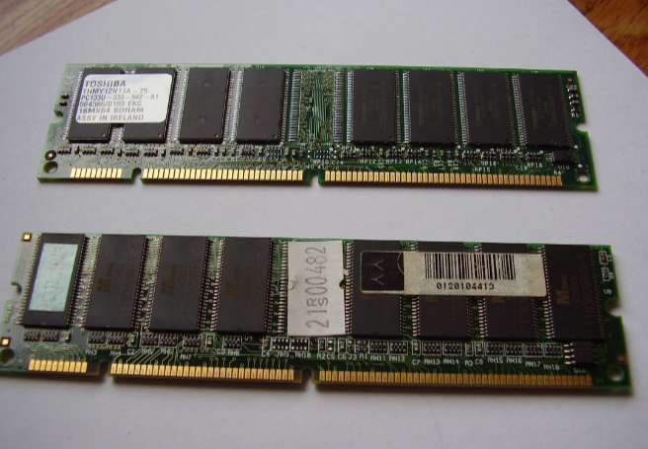
Basics of Memory Management
Definition and Purpose
Memory management is crucial for optimizing the use of computer memory, enabling multiple processes to run simultaneously without conflict.
Virtual Memory Concept
Virtual memory allows an operating system to use disk space as an extension of RAM, effectively increasing available memory beyond physical limits.
Segmentation and Paging Overview
These techniques help manage memory by dividing it into manageable sections, facilitating more efficient allocation and access.

Slide 5
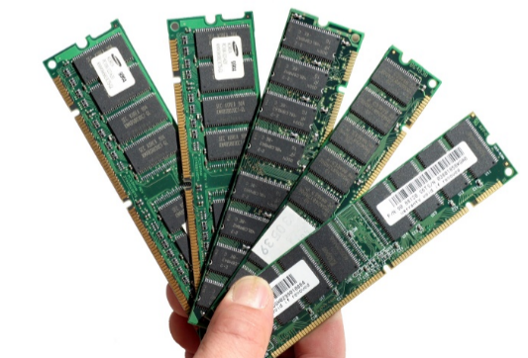
Understanding Segmentation in Memory Management
Definition of Segmentation
Segmentation divides the memory into variable-sized segments based on the logical units of a program.
Logical Address Space
Each segment has a unique segment number and an offset, defining its location and size.
Example of Segmentation
Programs may be segmented for code, stack, and heap, allowing independent management.

Slide 6
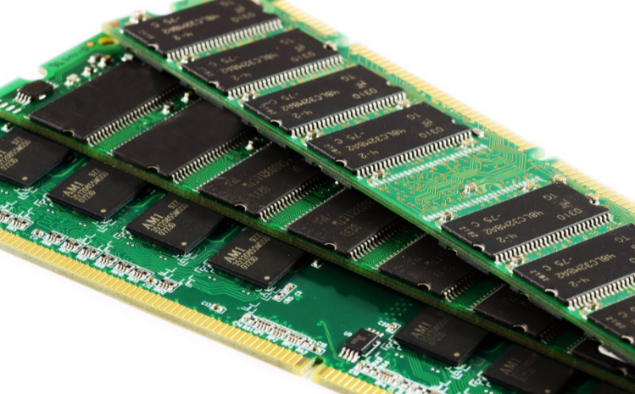
Paging Mechanism
Definition of Paging
Page Table Role
Example of Paging
Paging breaks physical memory into fixed-size frames and logical memory into pages of the same size, simplifying memory allocation and access.
A page table maps logical page numbers to physical frame numbers, enabling efficient translation during memory accesses.
For example, if a program requires 10 pages, these can be loaded into any available frames in physical memory, allowing non-contiguous memory allocation.

Slide 7
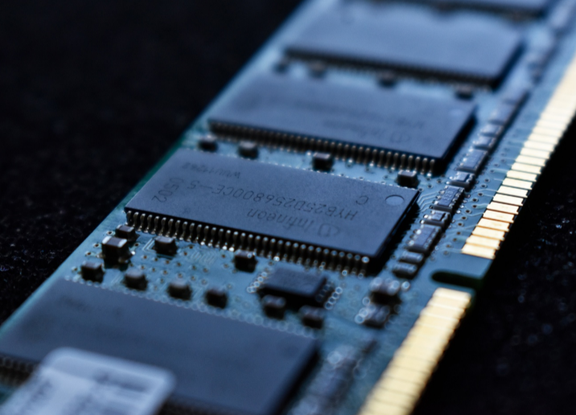
Address Translation Process
Combining Segmentation and Paging
Translation Lookaside Buffer (TLB)
Visual Diagram of Address Translation
Modern systems often use segmentation and paging together for better memory management.
TLB acts as a cache to enhance speed and reduce latency during address translation.
A visual representation highlighting the flow from logical to physical addressing involving segmentation, paging, and TLB.

Slide 8
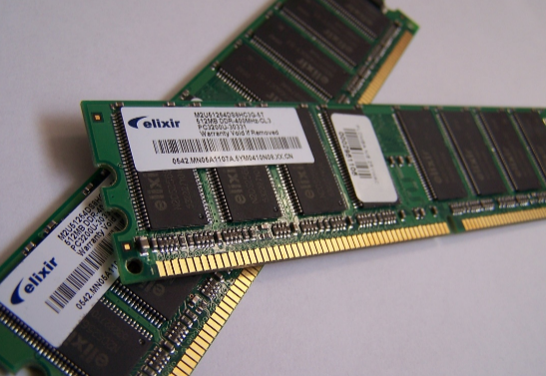
Advantages and Disadvantages of Memory Management
Benefits of Segmentation
Benefits of Paging
Potential Drawbacks
Segmentation provides logical separation of program components.
Paging eliminates external fragmentation.
Segmentation can cause internal fragmentation, while paging introduces overhead from page tables.

Slide 9
THANK YOU

